Slide 1
Reactive Programming
AND
EVENT-DRIVEN STYLES

Slide 2



Programming Languages that support Event-Driven Programming Styles

Slide 3
1
Where is it used?
Companies and products

Slide 7
4
Who uses them?
Companies and products

Slide 8

NETFLIX
Uses both flavors of Rx from Javascript and Microsoft’s .NET platform to power Playstation and Windows clients
Ported Rx to Java platform for servers
RxJava actually developed by engineers at Netflix
Now a required learning for many developers at Netflix

Slide 9

SOUNDCLOUD
Uses reactive programming for simplifying asynchronous concurrent code in mobile apps for android and IOS
For android, Netflix’s RxJava library is used
Matthias Käppler is a SoundCloud engineer and a contributor to the RxJava Android library and blogs about the HOWs and WHYs of RxJava on Android.

Slide 10

For those who are interested in more
Short Interview with Käppler
Käppler’s Site and Blog
RxJava Android library
https://youtu.be/DA0ZAnxUKDk
http://mttkay.github.io/blog/2013/08/25/functional-reactive-programming-on-android-with-rxjava/
https://github.com/Netflix/RxJava/tree/master/rxjava-contrib/rxjava-android

Slide 11






OTHER COMPANIES USING REACTIVEX

Slide 12

Switched from legacy Oracle system to Akka Platform from Lightbend
Old system requires 20gb memory whereas Akka on JVM needs under 500mb.
Much more memory efficient
Total cost of ownership cut in half
Average customer response time went from six seconds to 2.4 seconds
1.6 thousand orders per minute improved to 12,000 per minute

Slide 13

used the following technologies:
Spring Boot as fundamental application framework
Reactor (Core), implementation of the reactive API
Spring’s WebFlux for HTTP based communication with reactive API
Reactor Kafka, a reactive API built on top of Apache’s Kafka API

Slide 14
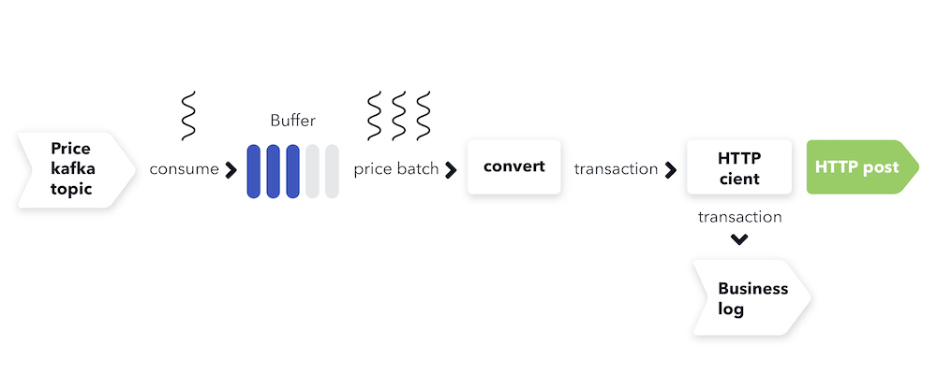
BUILT FULLY REACTIVE PIPELINE START TO FINISH

Slide 15
5
Comparison
Reactive Programming

Slide 16
COMPARING IMPLEMENTATIONS
API
PL
Library
ReactiveX
Red
ObservableComputations
Library Implementations for many languages: RxJava, RxPy, Rx.NET, etc.
Event streams
asynchronous
Most popular
OOP using a push model instead of streams
Simple and efficient
asynchronous
Cross-platform .NET library
asynchronous

Slide 17
6
Learning RP
Difficulty and resources

Slide 18
High Difficulty Initially
1. Paradigm
2. No Resources
Need to let go of old imperatives and thinking patterns and think in Reactive
This can be very frustrating and is the most important part
Most material on learning RP is usually too complex or generic
Lack of tutorials
Library documentation is difficult to use to learn

Slide 19
Learning resources
The introduction to Reactive Programming you've been missing
Python Concurrency Tutorial
https://gist.github.com/staltz/868e7e9bc2a7b8c1f754
This is the best intro and addresses the issues mentioned previously
https://www.tutorialspoint.com/concurrency_in_python/concurrency_in_python_reactive_programming.htm
CourseEra
Book: “Reactive Programming with RxJava”
Classes are free for California residents. https://c4b-integration.com/csl
Good for learning the concepts even if it is written for RxJava

